Slide 1
Forecasting Crude Oil Prices
Using the AR, MA, and ARIMA models.

Slide 2
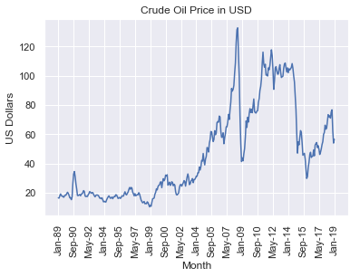
Look at the Time Series Data Without Differencing
The data was obtained from the Index Mundi website
The data is monthly, and it begins in January of 1989 and ends on January of 2019
The variation and mean of the data is time dependent.
The mean and variation increase as time moves forward.
The next slides shows that more clearly.

Slide 3
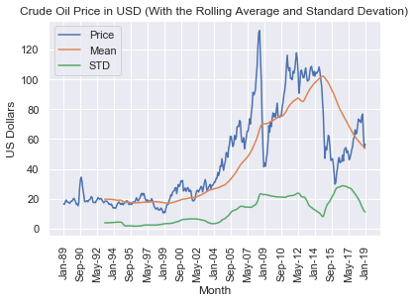
Time Dependent Data
The plot on this slides has the mean and the standard variation plotted along with the data
It can be seen that the mean and standard deviation increase with time.
The time dependent data needs to be manipulated in order to use the data for forecasting.

Slide 4
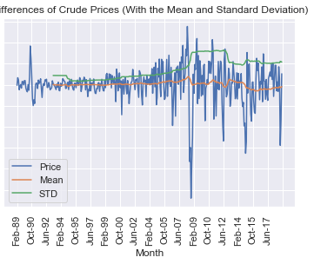
Differencing the Data
The data was differenced to address the time dependency in the data
The value of time t was subtracted from time t-1 for each data point.
After this alteration of the data, the autocorrelation explored as part of diagnostics.

Slide 5
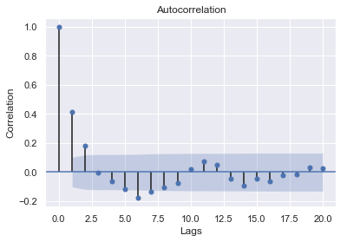
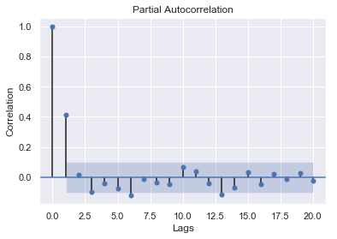
Autocorrelation (Diagnostics)
In the plot to the right, it is seen that the two lags, in relation to any data point, are correlated with the data point in question.
However, the correlation of the second lag to the current price is due to its correlation to the first lag
The partial correlation plot shows that only the first lag is directly correlated to the current price.

Slide 6
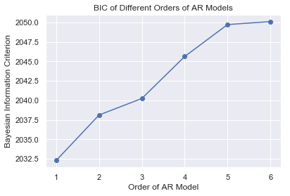
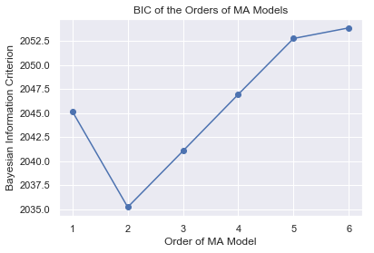
Bayesian Information Criteria for AR and MA
The BIC indicates that the order 1 of the AR is the best, due to it being the minimum.
The BIC was also consulted to determine the best order in regard to the Moving Average.
The first and second lags of the error term are correlated to the current price.

Slide 7
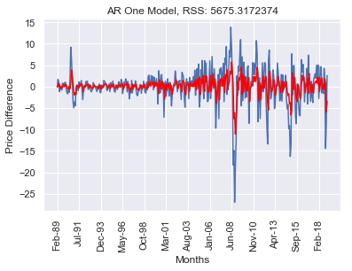

Forecasts of AR and MA and Metrics
Plotted are the differenced forecasts of the AR 1 and MA 2 models.
The residual sum of squares for the AR and MA models are 5675.317 and 5628.54 respectively.
We now combine the models and compare the combined model to the AR and MA models.

Slide 8
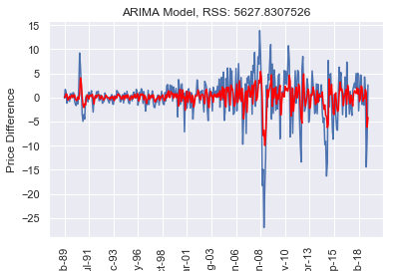
The ARIMA Model
The ARIMA model has a RSS of 5627.83, which is lower than those of the AR and MA models indicating that eh ARIMA model fit the data best.
Next, we train and test the ARIMA model with the order of AR being 1 and that of MA being 2.

Slide 9
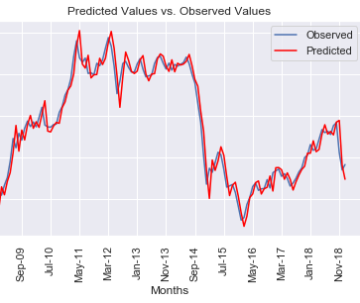
Training and Testing the ARIMA Model
We begin this process by splitting the data into training and testing sets, using a third of the data as the test set.
The model is fitted to the training data set.
The fitted model is then used to forecast.
The preceding testing data point is used to make the current forecast
The data is then undifferenced to get the actual price forecast.
The predicted (undifferenced) values are plotted along the actual value.
The average error from the test set is 6.09%

Slide 10
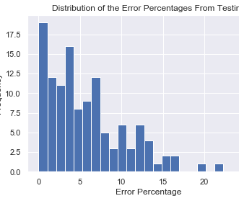
Distribution of the Error Percentages

